Slide 1
Data Mining

Slide 2
What Is Data Mining?
Data mining (knowledge discovery from data)
Extraction of interesting (implicit, previously unknown and potentially useful) patterns or knowledge from huge amount of data
Data mining: a misnomer?
Alternative names
Knowledge discovery (mining) in databases (KDD), knowledge extraction, data/pattern analysis, data archeology, data dredging, information harvesting, business intelligence, etc.

Slide 3
Data Mining: Confluence of Multiple Disciplines
Machine
Learning
Pattern
Recognition
Statistics
Applications
Data Mining
Visualization
Algorithm
Database
Technology
High-Performance
Computing

Slide 4
Chapter 2: Data Preprocessing
Why Data Preprocessing?
Data in the real world is dirty
incomplete: lacking attribute values, lacking certain attributes of interest, or containing only aggregate data
e.g., occupation=“ ”
noisy: containing errors or outliers
e.g., Salary=“-10”
inconsistent: containing discrepancies in codes or names
e.g., Age=“42” Birthday=“03/07/1997”

Slide 5
Why Is Data Preprocessing Important?
No quality data, no quality mining results!
Quality decisions must be based on quality data
e.g., duplicate or missing data may cause incorrect or even misleading statistics.
Data warehouse needs consistent integration of quality data
Data extraction, cleaning, and transformation comprises the majority of the work of building a data warehouse

Slide 6
Major Tasks in Data Preprocessing
Data cleaning
Fill in missing values, smooth noisy data, identify or remove outliers, and resolve inconsistencies
Data integration
Integration of multiple databases, data cubes, or files
Data transformation
Normalization and aggregation
Data reduction
Obtains reduced representation in volume but produces the same or similar analytical results
Data discretization
Part of data reduction but with particular importance, especially for numerical data

Slide 7
Boxplot Analysis
Five-number summary of a distribution:
Minimum, Q1, M, Q3, Maximum
Boxplot
Data is represented with a box
The ends of the box are at the first and third quartiles, i.e., the height of the box is IRQ
The median is marked by a line within the box
Whiskers: two lines outside the box extend to Minimum and Maximum

Slide 8
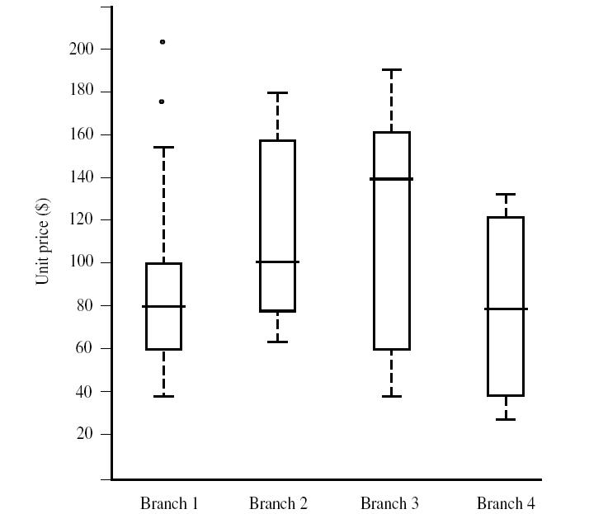
Boxplot Analysis

Slide 9
Data Cleaning
Importance
“Data cleaning is one of the three biggest problems in data warehousing”—Ralph Kimball
“Data cleaning is the number one problem in data warehousing”—DCI survey
Data cleaning tasks
Fill in missing values
Identify outliers and smooth out noisy data
Correct inconsistent data
Resolve redundancy caused by data integration

Slide 10
How to Handle Missing Data?
Ignore the tuple: not effective when the percentage of missing values per attribute varies considerably.
Fill in the missing value manually: tedious + infeasible?
Fill in it automatically with
a global constant : e.g., “unknown”, a new class?!
the attribute mean
the attribute mean for all samples belonging to the same class: smarter
the most probable value: inference-based such as Bayesian formula or decision tree

Slide 11
Data Transformation: Normalization
Min-max normalization: to [new_min_{A}, new_max_{A}]
Ex. Let income range $12,000 to $98,000 normalized to [0.0, 1.0]. Then $73,000 is mapped to
Z-score normalization (μ: mean, σ: standard deviation):
Ex. Let μ = 54,000, σ = 16,000. Then
Normalization by decimal scaling
Where j is the smallest integer such that Max(|ν’|) < 1

Slide 12
Chapter 3: Mining Frequent Patterns, Association and Correlations
Frequent pattern: a pattern (a set of items, subsequences, substructures, etc.) that occurs frequently in a data set
First proposed by Agrawal, Imielinski, and Swami [AIS93] in the context of frequent itemsets and association rule mining
Motivation: Finding inherent regularities in data
What products were often purchased together?— Bread and milk?!
What are the subsequent purchases after buying a PC?
Can we automatically classify web documents?
Applications
Basket data analysis, Web log (click stream) analysis, and DNA sequence analysis.

Slide 13
Basic Concepts: Association Rules
Tid
Items bought
Find all the rules X → Y with minimum support and confidence
support, s, probability that a transaction contains X ∪ Y
confidence, c, conditional probability that a transaction having X also contains Y
Let minsup = 50%, minconf = 50%
Freq. Pat.: Bread:3, Nuts:3, Cheese:4, Eggs:3, {Bread, Cheese}:3
10
Bread, Nuts, Cheese
20
Bread, Coffee, Cheese
30
Bread, Cheese, Eggs
40
Nuts, Eggs, Milk
50
Nuts, Coffee, Cheese, Eggs, Milk
Customer
buys both
Customer
buys cheese
Customer
buys bread
Association rules:
Bread →Cheese (60%, 100%)
Cheese → Bread (60%, 75%)

Slide 14
Apriori: A Candidate Generation-and-Test Approach
Apriori pruning principle: If there is any itemset which is infrequent, its superset should not be generated/tested! (Agrawal & Srikant @VLDB’94, Mannila, et al. @ KDD’ 94)
Method:
Initially, scan DB once to get frequent 1-itemset
Generate length (k+1) candidate itemsets from length k frequent itemsets
Test the candidates against DB
Terminate when no frequent or candidate set can be generated

Slide 15
The Apriori Algorithm—An Example
Sup_{min} = 2
Itemset | sup
{A} | 2
{B} | 3
{C} | 3
{D} | 1
{E} | 3
Database TDB
Itemset | sup
{A} | 2
{B} | 3
{C} | 3
{E} | 3
L₁
Tid | Items
10 | A, C, D
20 | B, C, E
30 | A, B, C, E
40 | B, E
C₁
1st scan
C₂
Itemset | sup
{A, B} | 1
{A, C} | 2
{A, E} | 1
{B, C} | 2
{B, E} | 3
{C, E} | 2
C₂
Itemset
{A, B}
{A, C}
{A, E}
{B, C}
{B, E}
{C, E}
L₂
Itemset | sup
{A, C} | 2
{B, C} | 2
{B, E} | 3
{C, E} | 2
2nd scan
C₃
Itemset
{B, C, E}
3rd scan
L₃
Itemset | sup
{B, C, E} | 2

Slide 16
Chapter 4: Classification
Classification
predicts categorical class labels (discrete or nominal)
classifies data (constructs a model) based on the training set and the values (class labels) in a classifying attribute and uses it in classifying new data
Classification—A Two-Step Process
Model construction
Model usage

Slide 17
Model construction: describing a set of predetermined classes
Each tuple/sample is assumed to belong to a predefined class, as determined by the class label attribute
The set of tuples used for model construction is training set
The model is represented as classification rules, decision trees, or mathematical formulae
Model usage: for classifying future or unknown objects
Estimate accuracy of the model
The known label of test sample is compared with the classified result from the model
Accuracy rate is the percentage of test set samples that are correctly classified by the model
Test set is independent of training set, otherwise over-fitting will occur
If the accuracy is acceptable, use the model to classify data tuples whose class labels are not know

Slide 18
Process (1): Model Construction
Classification
Algorithms
Training
Data
Classifier
(Model)
IF income = high then
loan_decision = safe
IF age = middle AND
income = low THEN
loan_decision = risky
…

Slide 19
Process (2): Using the Model in Prediction
Classifier
Testing
Data
Unseen Data
(Jeff, middle, low)
loan_
decision?
Risky

Slide 20
Decision Tree Induction: Training Dataset
This follows an example of Quinlan’s ID3 (Playing Tennis)

Slide 21
Output: A Decision Tree for “buys_computer”
age?
<=30
>40
31..40
student?
yes
credit rating?
no
yes
excellent
fair
no
yes
no
yes

Slide 22
Algorithm for Decision Tree Induction
Basic algorithm (a greedy algorithm)
Tree is constructed in a top-down recursive divide-and-conquer manner
At start, all the training examples are at the root
Attributes are categorical (if continuous-valued, they are discretized in advance)
Examples are partitioned recursively based on selected attributes
Test attributes are selected on the basis of a heuristic or statistical measure (e.g., information gain)
Conditions for stopping partitioning
All samples for a given node belong to the same class
There are no remaining attributes for further partitioning – majority voting is employed for classifying the leaf
There are no samples left

Slide 23
Attribute Selection Measure: Information Gain (ID3/C4.5)
Select the attribute with the highest information gain
Let p_{i} be the probability that an arbitrary tuple in D belongs to class C_{i}, estimated by |C_{i, D}|/|D|
Expected information (entropy) needed to classify a tuple in D:
Information needed (after using A to split D into v partitions) to classify D:
Information gained by branching on attribute A

Slide 24
Attribute Selection: Information Gain
Class P: buys_computer = “yes”
Class N: buys_computer = “no”
means “age <=30” has 5 out of 14 samples, with 2 yes’es and 3 no’s. Hence
Similarly,

Slide 25
Lazy vs. Eager Learning
Lazy vs. eager learning
Lazy learning (e.g., instance-based learning): Simply stores training data (or only minor processing) and waits until it is given a test tuple
Eager learning (the above discussed methods): Given a set of training set, constructs a classification model before receiving new (e.g., test) data to classify
Lazy: less time in training but more time in predicting

Slide 26
The k-Nearest Neighbor Algorithm
All instances correspond to points in the n-D space
The nearest neighbor are defined in terms of Euclidean distance, dist(X₁, X₂)
Target function could be discrete- or real- valued
For discrete-valued, k-NN returns the most common value among the k training examples nearest to x_{q}
Voronoi diagram: the decision surface induced by 1-NN for a typical set of training examples
_
.
_
_
.
+
_
.
+
.
.
_
x_{q}
+
_
.
+

Slide 27
Discussion on the k-NN Algorithm
k-NN for real-valued prediction for a given unknown tuple
Returns the mean values of the k nearest neighbors
Distance-weighted nearest neighbor algorithm
Weight the contribution of each of the k neighbors according to their distance to the query x_{q}
Give greater weight to closer neighbors
Robust to noisy data by averaging k-nearest neighbors
Distance between neighbors could be dominated by irrelevant attributes
To overcome it, elimination of the least relevant attributes

Slide 28
Chapter 5: Clustering
Cluster: a collection of data objects
Similar to one another within the same cluster
Dissimilar to the objects in other clusters
Cluster analysis
Finding similarities between data according to the characteristics found in the data and grouping similar data objects into clusters
Unsupervised learning: no predefined classes
Typical applications
As a stand-alone tool to get insight into data distribution
As a preprocessing step for other algorithms

Slide 29
Clustering: Rich Applications and Multidisciplinary Efforts
Pattern Recognition
Spatial Data Analysis
Create thematic maps in GIS by clustering feature spaces
Detect spatial clusters or for other spatial mining tasks
Image Processing
Economic Science (especially market research)
WWW
Document classification
Cluster Weblog data to discover groups of similar access patterns

Slide 30
Examples of Clustering Applications
Marketing: Help marketers discover distinct groups in their customer bases, and then use this knowledge to develop targeted marketing programs
Land use: Identification of areas of similar land use in an earth observation database
Insurance: Identifying groups of motor insurance policy holders with a high average claim cost
City-planning: Identifying groups of houses according to their house type, value, and geographical location

Slide 31
The K-Means Clustering Method
Given k, the k-means algorithm is implemented in four steps:
Partition objects into k nonempty subsets
Compute seed points as the centroids of the clusters of the current partition (the centroid is the center, i.e., mean point, of the cluster)
Assign each object to the cluster with the nearest seed point
Go back to Step 2, stop when no more new assignment

Slide 32
The K-Means Clustering Method
Example
10
10
9
9
8
8
7
7
6
6
5
5
4
Assign each objects to most similar center
Update the cluster means
4
3
3
2
2
1
1
0
0
0
1
2
3
4
5
6
7
8
9
10
0
1
2
3
4
5
6
7
8
9
10
reassign
reassign
K=2
Arbitrarily choose K object as initial cluster center
Update the cluster means

